Slide 1
OIS 6660
Adam Tidwell
11/6/14

Slide 2

Agenda
Quiz 1
Lecture
Scope Management overview
Plan Scope Management
Collect Requirements
Define Scope
Create WBS
Validate Scope
Control Scope
Case Study 1
Group project
Project Charter
CAPM/PMP Preparation

Slide 3

Quiz 1
On Canvas
30 minutes
Closed book/internet

Slide 4
Lecture
PMBOK: Chapter 5
Scope Management

Slide 5
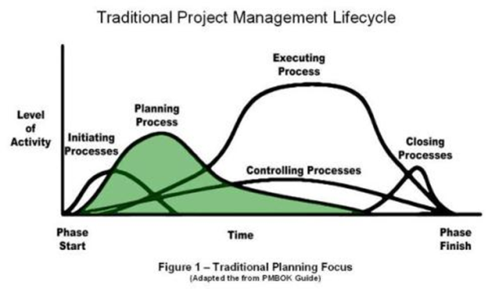
Planning Process
Notes:
Initiation – talking to stakeholders
Planning – scope, time and cost

Slide 6
All the work required and only the work required…
Notes:
Scope creep, gold plating
WBS – work breakdown structure

Slide 7
Plan Scope Management
Determines the methodology for determining the scope
Decides how the scope will be monitored and changed if needed
Administrative process
Inputs: Project Charter, enterprise environmental factors, organizational process assets, Project Management plan
Tools & Techniques: Expert judgment, meetings
Outputs: Scope Management Plan, Requirements
Management Plan
Notes:
‘Who’s It?’ exercise
We have to have a way to determine the rules in the game and in project management.
Know inputs, tools & techniques and outputs for quiz
Expert judgment – talking to people to know

Slide 8
Collect Requirements
Determine stakeholder requirements
Must be measureable
Inputs: Project Charter, Stakeholder Register, Scope Management Plan, Requirements Management Plan, Stakeholder Management Plan
Tools & Techniques: Interviews, focus groups, brainstorming, affinity diagram, observations, benchmarking, etc.
Outputs: Requirements documentation
Make sure you know your requirements before you buy
Notes:
SMART goals- specific, measurable, attainable, realistic, timely
Brainstorming
What do we want to get out of this session?
Brainstorm ideas for a set time
Group and summarize ideas
Think it through/discuss
List in order of preference
Create plan
Disney: outsiders (analytics), dreamers (what if), realists (let’s be practical), critics (that won’t work)

Slide 9

Define Scope
Detailed description of the project
Take the collected requirements and decide what it will be
Inputs: Scope Management Plan, Project Charter, Requirements Documentation, organizational process assets,
Tools & Techniques: Expert judgment
Output: Project Scope Statement (scope description,
acceptance criteria, deliverable, what is out of scope,
constraints, assumptions)
Monster budget model

Slide 10

Create WBS
Subdividing project steps into smaller steps
Structured and organized list
Work package- lowest level
Inputs: requirements documentation, enterprise environmental factors, organizational process assets, Scope Management Plan
Tools & Techniques:
Decomposition- breaking into smaller steps
Outputs: Scope Baseline (scope statement, WBS, WBS Dictionary)
Notes:
How do we know when to stop breaking down the tasks?
Sticky Note exercise- what is the right level of detail?

Slide 11

Validate Scope
Validates that what was produced matches the scope that was planned
Inputs: Project Management plan, requirements documentation, Requirements Traceability Matrix, verified deliverables, work performance data
Tools & Techniques: Inspection, group decision making
Outputs: Accepted deliverables
Formal sign off goes to Close process

Slide 12
Control Scope
Make sure the scope is what it is supposed to be, and if changes are needed, manage those changes
Inputs: Project Management Plan, requirements documentation, Requirements Traceability Matrix, work performance data, organizational process assets
Tools & Techniques: variance analysis
Outputs: work performance information, change requests, Project Management Plan updates
Notes:
This is a function to change things

Slide 13

Case Study 1: Bradley Fighting Vehicle

Slide 14
Group Project
Create Project Charter form
Complete Project Charter
Notes:
Sample Project Charters are found in the Form Example folder by week on Canvas.

Slide 15
Project Charter
Why the project is being done
Measurable success criteria
Assumptions
Description of the project
High level risks
High level milestones
High level budget
Stakeholders
Roles and responsibilities
Official sign off
More?

Slide 16
Preparing for the PMP/CAPM Exam
Notes:
Prepare slides for the appendix in the event that more details or supplemental slides are needed. The appendix is also useful if the presentation is distributed later.

Slide 17
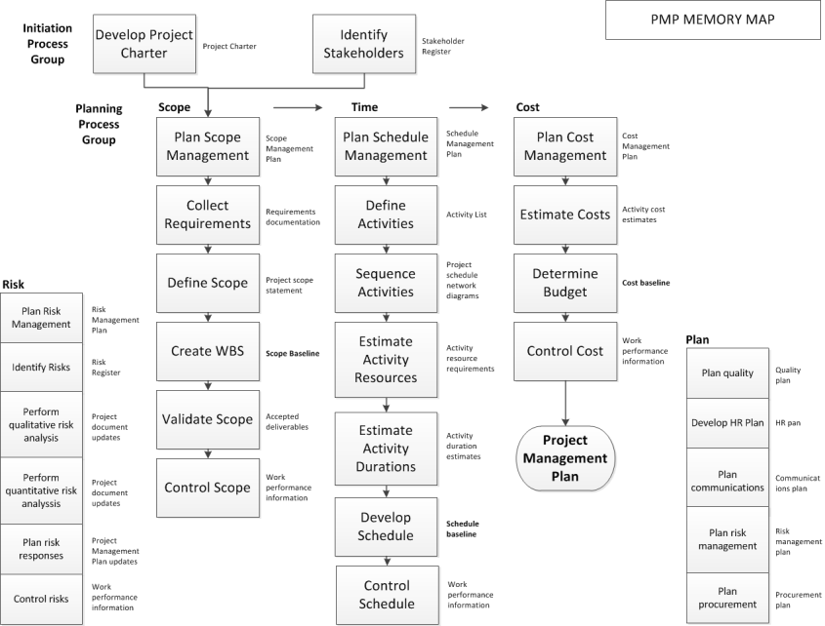
Notes:
Memorize this and use it on the test.
Blank forms are found in the test preparation folder.

